Slide 1
Week 6. Environments
A. Michelle Lawing, PhD
Associate Professor
Paleobiology, Evolution, and Climate Lab
Ecology and Conservation Biology
Texas A&M University
alawing@tamu.edu

Slide 2
Welcome, hello, any announcements?

Slide 3
Project Milestones
Date | Milestone
Sept. 11 | Project topic
Oct. 2 | Data plan
Oct. 23 | Modeling plan
Nov. 6 | Preliminary results
Dec. 1 (optional) | Full final draft due
Dec. 10 1-3 pm (finals slot) | Presentation
Dec. 11 | Final paper

Slide 4
Class Plan
Finish talking about environments
Brief coding review
Lab 04 prep

Slide 5
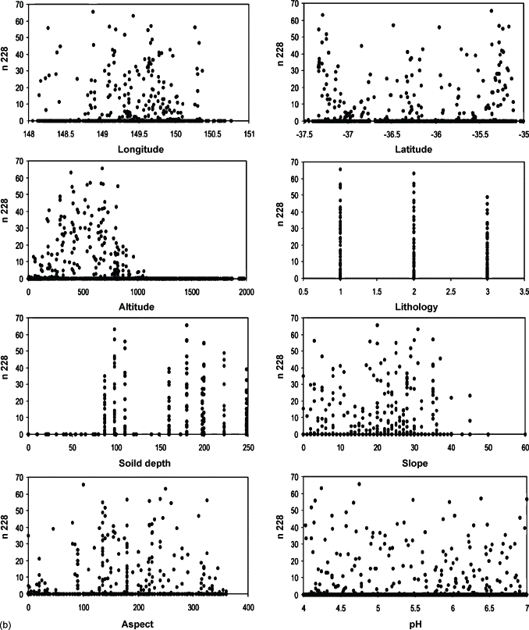
Species–environment relationships
Species respond to different combinations of environmental conditions
Relevant predictors differ among species and geographic contexts
A statistical association does not necessarily identify a causal mechanism
Figure 6.1. Example summary of responses of a virtual species to eight environmental characteristics. Adapted from Austin et al. (2006).

Slide 6
Direct v indirect effects

Slide 7
n228 is the name of the virtual species
Each point represents one simulated site
Y is the abundance of the species at each site

Slide 8
n228 is the name of the virtual species
Each point represents one simulated site
Y is the abundance of the species at each site

Slide 9
Austin et al. (2006)
Austin et al. were making the point that when the true biological response is expressed through indirect predictors, the underlying ecological relationship can become much harder to see.
They explicitly note that the species–environment relationships are relatively obscure for variables such as longitude, latitude, slope, and aspect, even though some of those variables are linked through environmental processes to the actual causal variables.

Slide 10
Temporal resolution

Slide 11
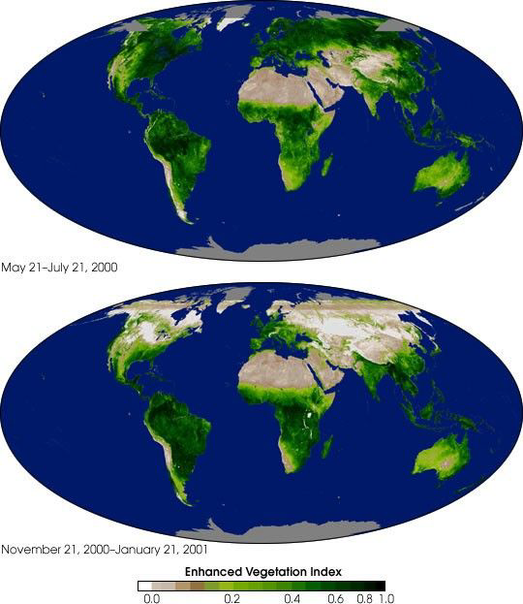
Temporal resolution
Occurrence records and environmental predictors should represent fairly compatible periods
Topography changes slowly, but vegetation and land cover can change rapidly
Remote-sensing products require particularly careful temporal matching
Past and future projections require environmental layers from the corresponding period

Slide 12
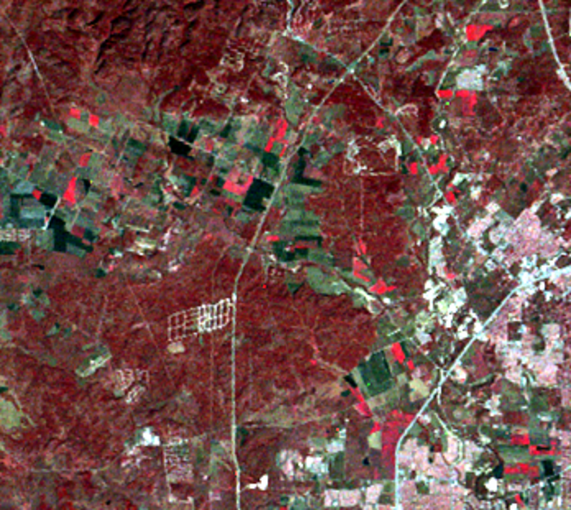
USGS Landsat San Antonio, TX 1974
Healthy vegetation strongly reflects near-infrared light.
The image assigns that invisible near-infrared signal to the visible red channel:
Bright red: dense or actively growing vegetation
Dark/dull red: sparser or less vigorous vegetation
White, gray, or cyan: roads, buildings, and exposed surfaces
Very dark areas: usually water

Slide 13
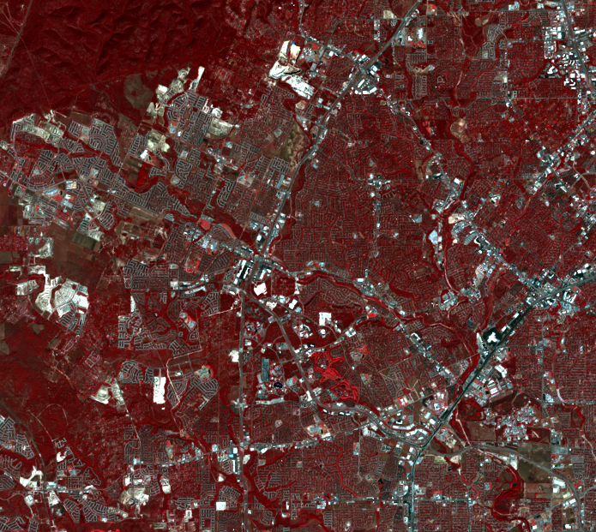
USGS Landsat San Antonio, TX 2022
The expanding pale-gray street and development patterns show urban growth replacing or fragmenting vegetation.

Slide 14
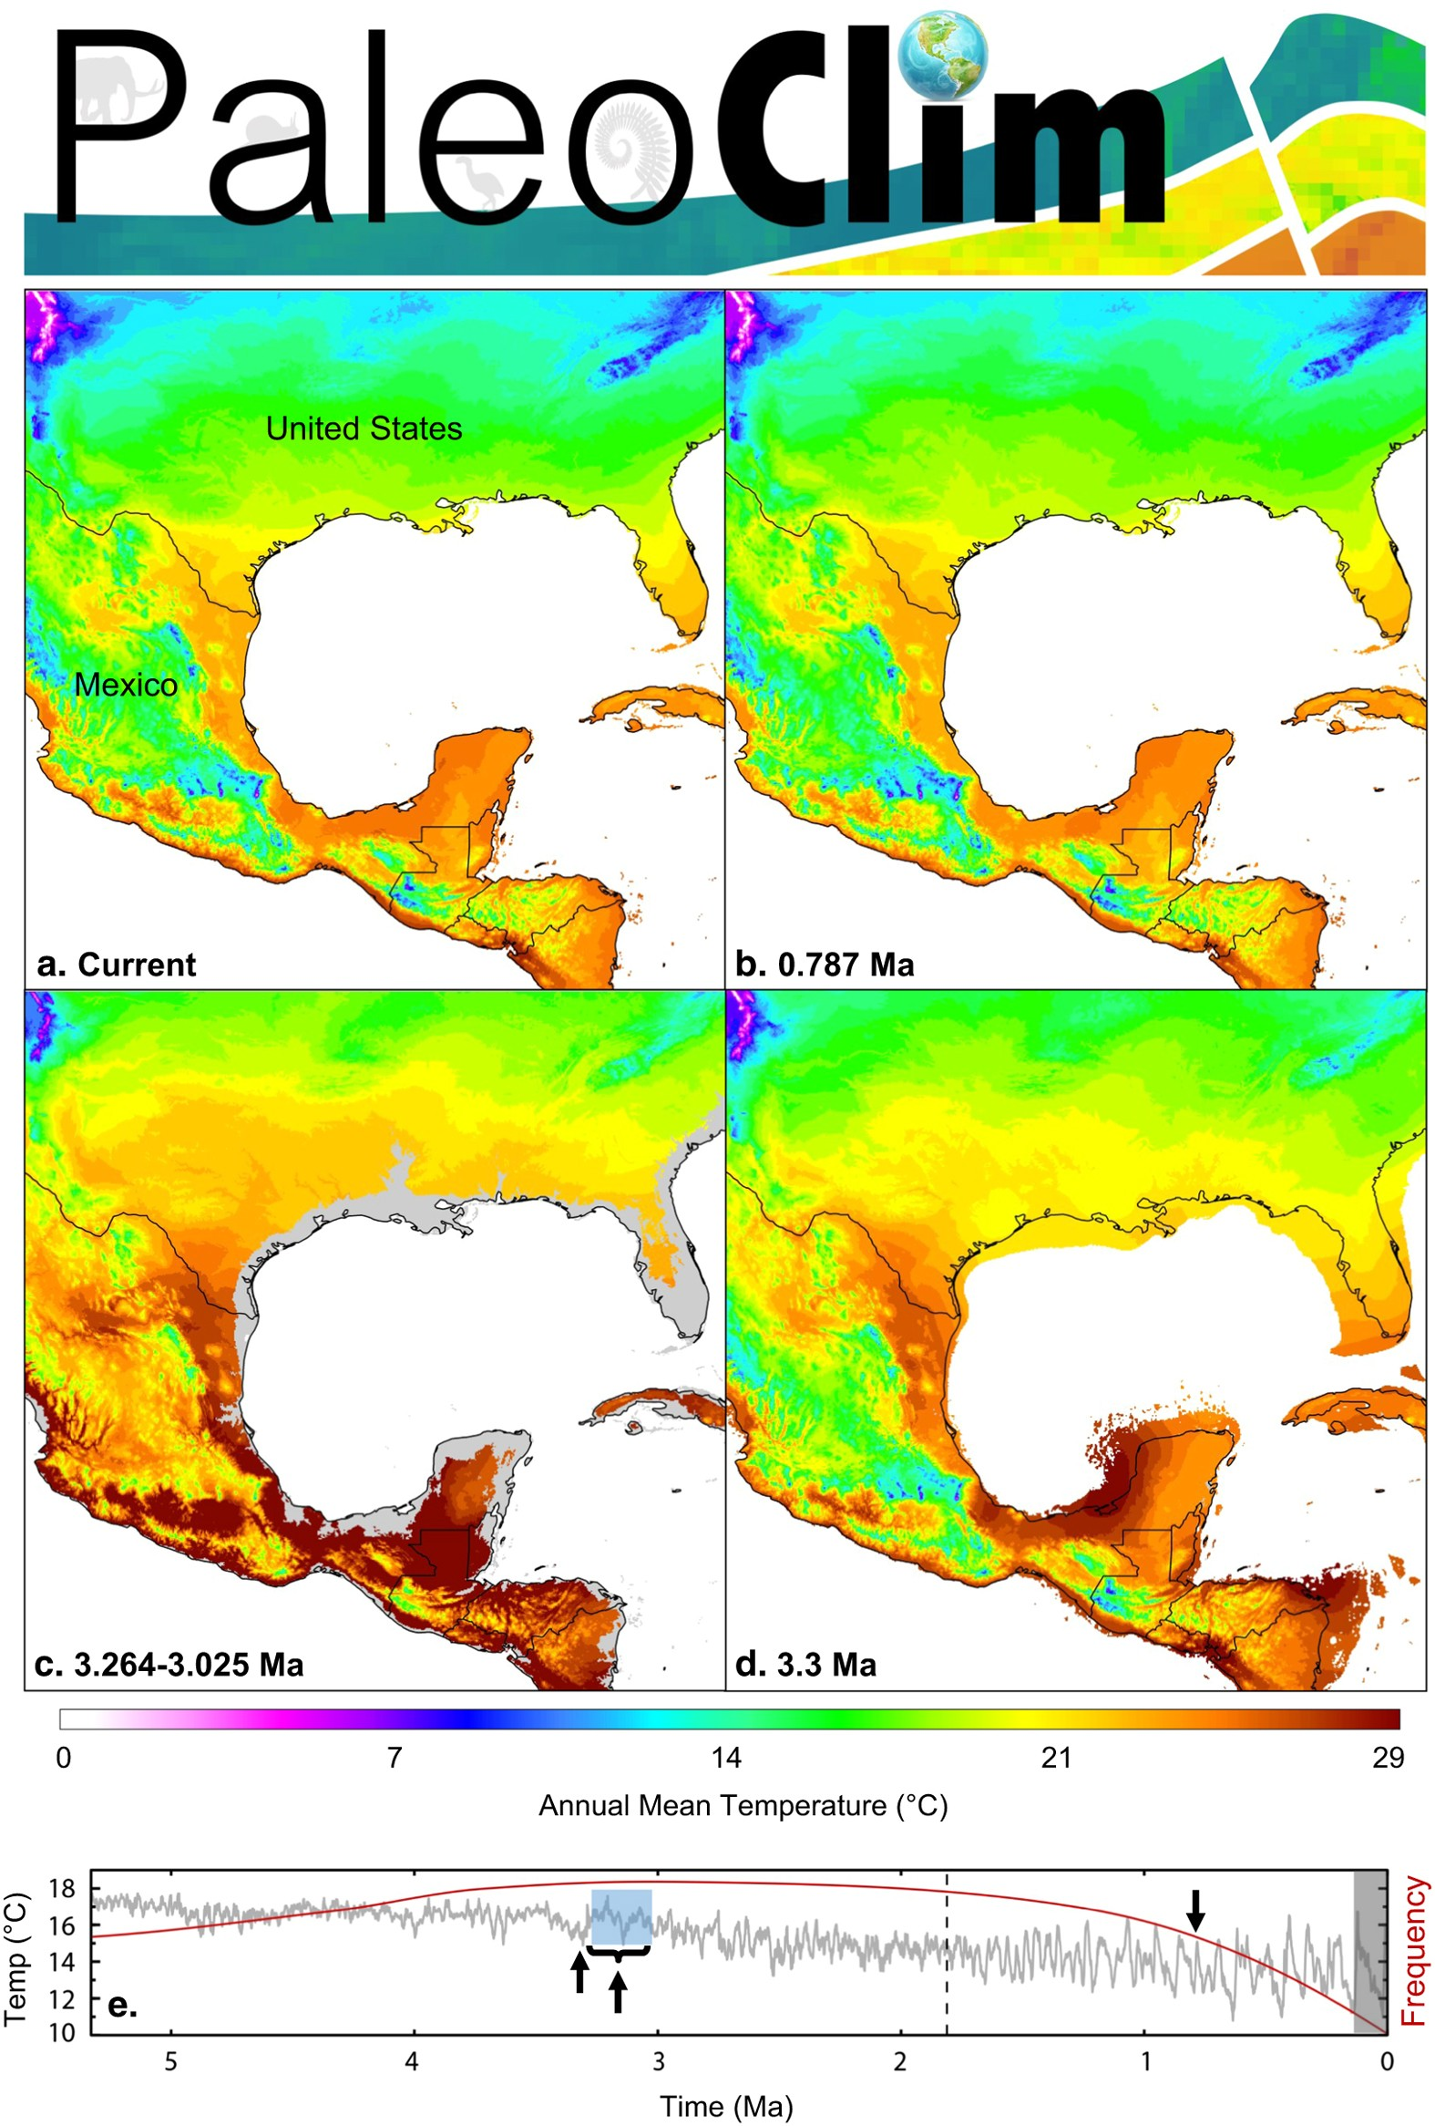
Climate Change Through Geological Time
PaleoClim layers are modeled reconstructions of past change
Climate and coastlines have changed through time
Suitable environments may shift, expand, contract, or fragment
A stable climatic niche can produce a changing geographic range
Brown, J.L., Hill, D.J., Dolan, A.M., Carnaval, A.C. and Haywood, A.M., 2018. PaleoClim, high spatial resolution paleoclimate surfaces for global land areas. Scientific data, 5(1), p.180254.

Slide 18
Environmental data sources and types
Common sources:
Interpolated weather-station data
Climate-model simulations
Remotely sensed imagery
Data may be categorical, ordinal, interval, or continuous. The modeling method needs to handle each type correctly.

Slide 19
Modern extension: projection risks
Projection layers must use the same variables, units, and definitions as calibration layers
Identify environments outside the calibration range using tools such as MESS or MOP
Predictions in novel environments depend on extrapolation assumptions
Compare results across climate models, predictor sets, and resolutions to quantify uncertainty

Slide 20
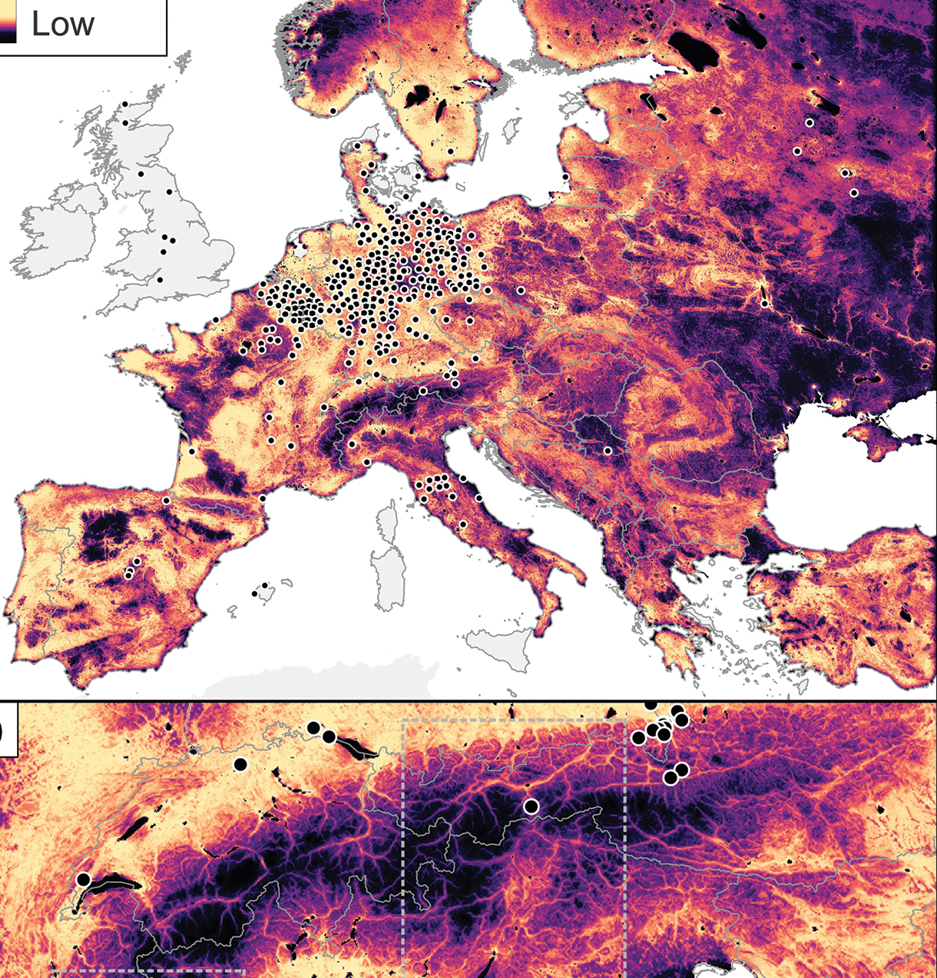
Ancillary data
Geographic barriers, dispersal history, and land use help explain occupied distributions
These layers can refine niche-model predictions after model calibration
Latitude and longitude should not substitute for environmental mechanisms when ecological interpretation or transfer is the goal
Falaschi, M., Simoncini, A., Ancillotto, L., Viviano, A., Menchetti, M., Mazza, G. and Mori, E., 2025. Crossing borders: Connectivity analyses reveal potential patterns of range expansion of the Northern raccoon in Europe. NeoBiota, 99, pp.71-92.

Slide 21
Environmental-data audit
When you select your predictor variables, be sure to answer the following questions.
What ecological process does it represent?
Is it direct, indirect, or a resource?
What are its extent, resolution, and time period?
How was it generated?
What mismatch or uncertainty in this variable could affect the model?

Slide 22
Environmental data practicalities

Slide 23
Environmental data file types
GeoTIFF (.tif)
NetCDF (.nc)
sometimes CSV or other spatial formats
library(terra)
temp <- rast("data/environment/temperature.tif")

Slide 24
Working with multiple environmental variables
temp <- rast("data/environment/temperature.tif")
precip <- rast("data/environment/precipitation.tif")
env <- c(temp, precip)
names(env) <- c("temperature", "precipitation")
env
plot(env)

Slide 25
Occurrence points and rasters need to align
You may need to:
transform a CRS
crop the environmental data
check the raster resolution
check that all layers line up
st_crs(occ_sf)
crs(env)
env_crop <- crop(env, vect(occ_sf))

Slide 26
Transform variables
precip_log10 <- log10(env[["precipitation"]])
names(precip_log10) <- "precip_log10"

Slide 27
Extract environmental values at occurrences
occ_vect <- vect(occ_sf)
occ_env <- extract(env, occ_vect)
occurrence | temperature | precipitation
1 | 18.2 | 840
2 | 21.4 | 690
3 | 17.8 | 910

Slide 28
Data plan and Lab 04 prep
Identify at least 3 (no more than 6) environmental predictors relevant to your project question.
Find and download one layer for each predictor.
Choose data at a reasonable spatial resolution and file size for your study area.
  If the dataset is very large, use a smaller geographic extent or coarser-resolution version.
  File-size guidelines: Keep individual environmental files ≤25 MB and your environmental-data folder ≤100 MB total.
Save the original downloaded files in your project data/ folder.
Commit and push your updated project to GitHub and verify the files are there.

